Slide 1



SYMPTOMATRIX
AI-Driven Multi-Agent System that revolutionizes medical diagnostics
Confidential : Relevance Lab Copyright 2024

Slide 2

AI-Driven Multi-Agent System for Medical Data Analysis
Introducing Symptomatrix: an innovative multi-agent AI system designed to revolutionize medical data analysis. Our solution addresses the complexity and time-consuming nature of medical diagnostics while improving accessibility to immediate medical insights for patients.
This presentation explores how our AI-driven medical chatbot provides detailed analysis, probabilistic treatment suggestions, and multi-language support through a user-friendly interface that seamlessly integrates advanced AI technology with practical healthcare applications.

Slide 3




Why This Matters
Improving Diagnostic Efficiency
Enhancing Accessibility
Bridging Technology Gaps
Our solution democratizes access to medical insights, providing patients with immediate, understandable information about their health concerns.
We connect advanced AI analysis capabilities with intuitive user experiences, making powerful technology accessible to both patients and providers.
By automating complex analysis, we reduce the time from symptom to diagnosis, allowing healthcare providers to focus on patient care rather than data processing.

Slide 4








Our Solution Approach
AI-Driven Medical Analyzer
Intelligent interaction hub
Detailed Analysis & Treatment Suggestions
Comprehensive health insights
Multi-Language Translation
Global accessibility
User-Friendly Interface
Seamless integration
Our solution combines these elements into a cohesive system that provides accessible medical insights through an intuitive interface. The AI-driven chatbot serves as the central point of interaction, delivering detailed analysis and treatment suggestions in the user's preferred language.

Slide 5


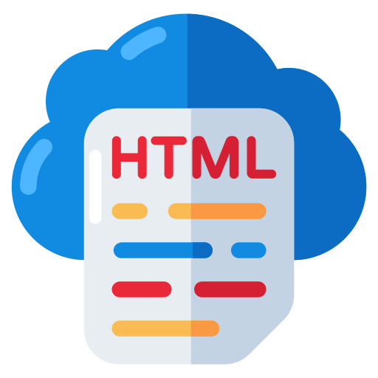











Relevance Lab AI Cloud Platform
End User
UI Components
Scrape Website Tool
Internet Data
Vue Web Components
Serper Dev Tool
Website Search Tool
Application
Client
Services$∗$
Generative AI Hub
API Service
Agents
Foundational Models
Destination Service
Data Management
Multilingual Agent
Allopathic Agent
App Router
Application Service
Ayurvedic Agent
OpenAI
GPT-4o-mini
Crew AI
Mod-Integ Agent
Image Analysis
Diet Agent
OpenAI
GPT-4
Tasks
Multilingual Task
Service Manager*
Allopathic Task
Ayurvedic Task
Mod-Integ Task
Destination Service
Diet Task
Vector Database*
Custom System Prompts
Custom Output Templet
* Future Plan

Slide 6
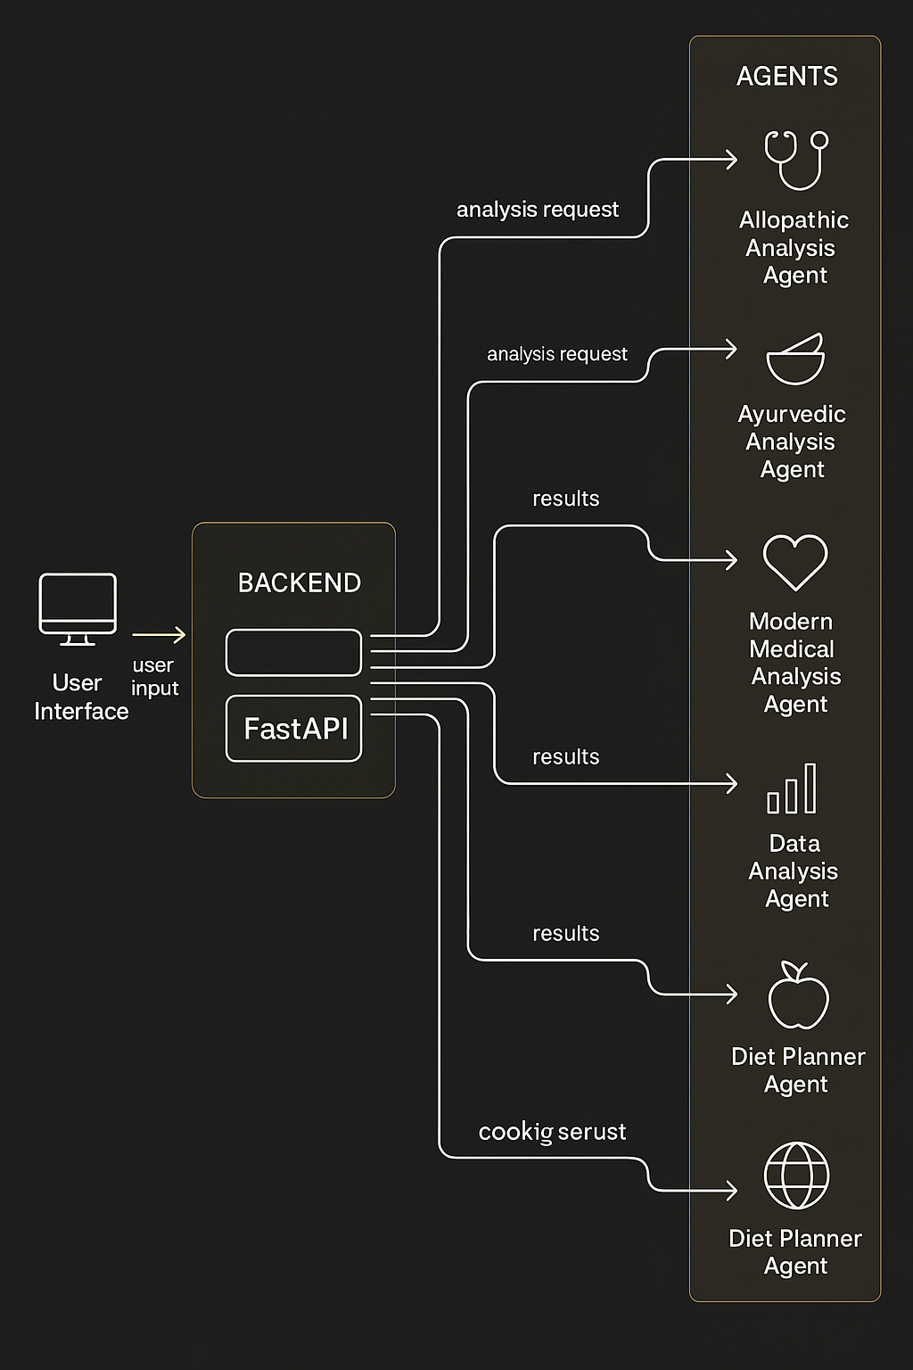




Symptomatrix Architecture
User Input
Patient enters symptoms, uploads images, or asks health questions through the Vue.js frontend
Backend Processing
FastAPI receives the request and routes it to the Supervisor Agent for orchestration
Multi-Agent Analysis
Specialized agents process the data according to their expertise areas
Response Generation
Comprehensive analysis is compiled and returned to the user interface
The Symptomatrix architecture follows a structured flow of interaction, processing, and response generation. It integrates several specialized agents working together to provide comprehensive healthcare analysis and recommendations.

Slide 7
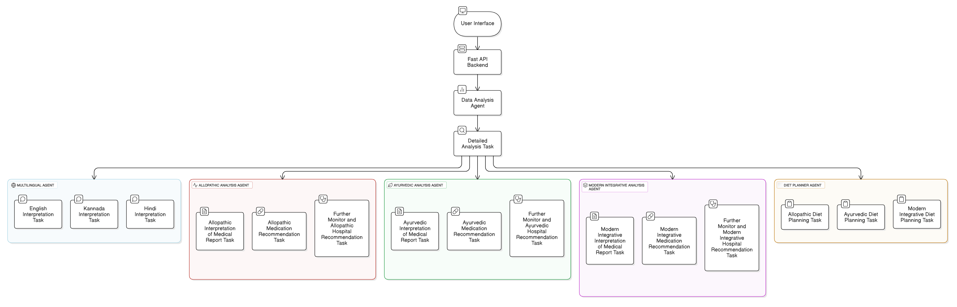
Intelligent Multi-Agent Medical Analysis and Recommendation System
(IMARS)

Slide 8
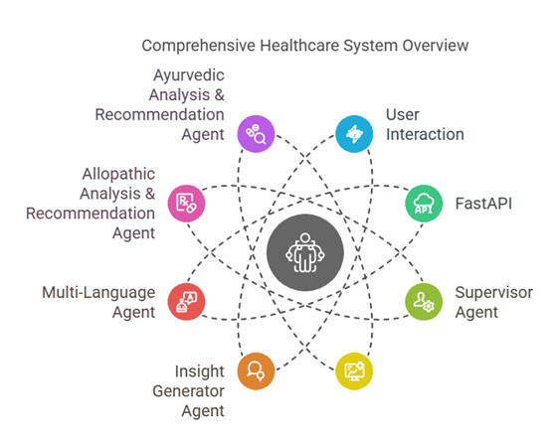
Multi-Agent System
Supervisor Agent
Central controller coordinating the entire system and managing data flow
Image Analyzer
Processes uploaded medical images using GPT-4o-Mini and computer vision
Medical Analysis Agents
Specialized agents for Allopathic, Ayurvedic, and Integrative approaches
Insight Generator
Creates detailed explanations using GPT-4 based on inputs and analysis
Multi-Language
Translates content for non-English speaking users
Built on Python with FastAPI, our backend leverages the CrewAI Framework to orchestrate multiple specialized AI agents. This scalable architecture allows for efficient data routing and modular design, where each agent works independently before returning results to the Supervisor.

Slide 9

Technology Stack
Frontend
Backend
AI Models
Vue.js v3 (JavaScript)
Python with FastAPI
GPT-4 for detailed analysis
Axios for API communication
CrewAI Framework
GPT-4o-Mini for image processing
Tailwind CSS for styling
Multi-Agent System architecture
FontAwesome for icons

Slide 10
Backend Features Highlights
Python (FastAPI): High-performance web framework for building APIs. Supports asynchronous operations, enabling fast data processing and interaction providing easy integration with AI models and multi-agent systems.
CrewAI Framework: A backend framework designed for managing and orchestrating multiple AI agents. Ensures efficient communication and task distribution between AI modules. Handles agent interactions through defined APIs and queues.
Multi-Agent System: The Supervisor Agent acts as the controller, managing the flow of data and delegating tasks to specialized agents. Data is dispatched to various agents based on the user's request type.
Key Highlight:
Scalable Architecture: New agents can be added easily.
Efficient Data Routing: CrewAI ensures optimized data flow between agents.
Modular Design: Each AI agent works independently and returns results to the Supervisor Agent.

Slide 11
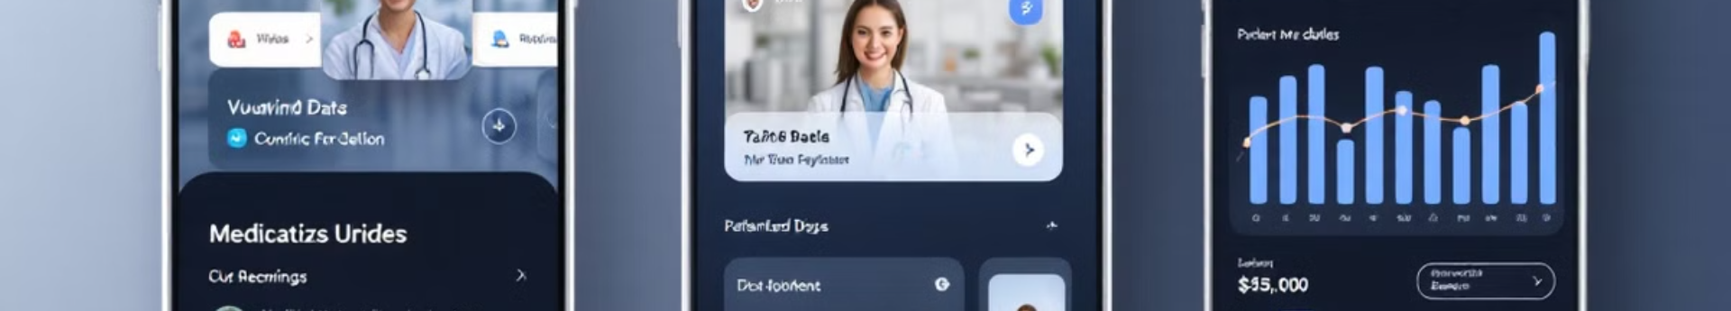




Frontend Features
Vue.js (v3)
Axios
Tailwind CSS
FontAwesome
Modular architecture with reusable components using Composition API for better state management and reusable logic, perfect for complex UIs.
Promise-based HTTP client for seamless API communication, handling requests and responses with effective error management between frontend and backend.
Utility-first CSS framework providing predefined classes for consistent, modern styling with easy customization via configuration files for flexible branding.
Popular icon library enhancing UI with various medical and AI icons, providing scalable vector graphics for a clean, professional appearance.

Slide 12
Future Enhancements
Improved Model Accuracy:
Continuously improving AI models (like GPT-4, GPT-4o-Mini) for higher precision in medical analysis and recommendations.
Incorporating advanced natural language processing (NLP) techniques for more accurate symptom understanding and query resolution.
Enhanced UI/UX:
Making the interface more user-friendly, interactive, and responsive.
Incorporating accessibility features for better inclusivity.
Improved visualizations for medical reports and recommendations.
More Medical Domains (ECG, MRI, etc.):
Expanding capabilities to analyze data from more medical domains beyond text-based interaction.
Integration of AI models trained specifically for analyzing ECG, MRI, etc.
Developing multimodal systems for comprehensive health analysis.
Cloud Deployment & Scalability:
Deploying the system on cloud platforms (AWS, Azure, GCP) for high availability and scalability.
Leveraging microservices architecture for handling various agents efficiently.
Ensuring efficient load-balancing and scaling during peak usage times.
HIPAA Compliance:
Health Insurance Portability and Accountability Act (HIPAA) is a US regulation ensuring data privacy and security for medical information.
Implementing security measures such as encryption, secure data transfer, and access control.
Ensuring the system meets required standards for confidentiality, integrity, and availability of medical data.

Slide 13

Transforming Healthcare Through AI
24/7
Availability
Continuous access to medical insights
3
Languages
Global accessibility through translation
3
Medical Approaches
Allopathic, Ayurvedic, and Integrative Medicine
Symptomatrix represents the future of healthcare analysis—where advanced AI meets user-friendly design to deliver accessible medical insights. By combining multiple specialized agents with a seamless interface, we're creating a system that empowers both patients and providers with immediate, comprehensive health information.
Our vision extends beyond current capabilities, with a roadmap for continuous improvement in accuracy, usability, and scope. Join us as we bridge the gap between complex medical data and actionable healthcare insights.

Slide 14
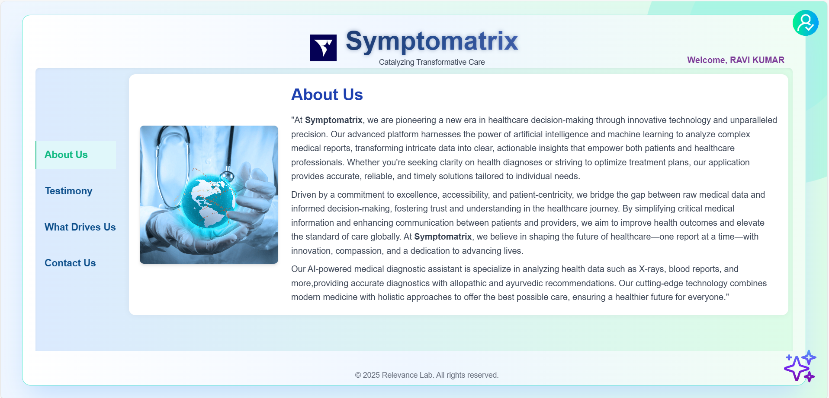
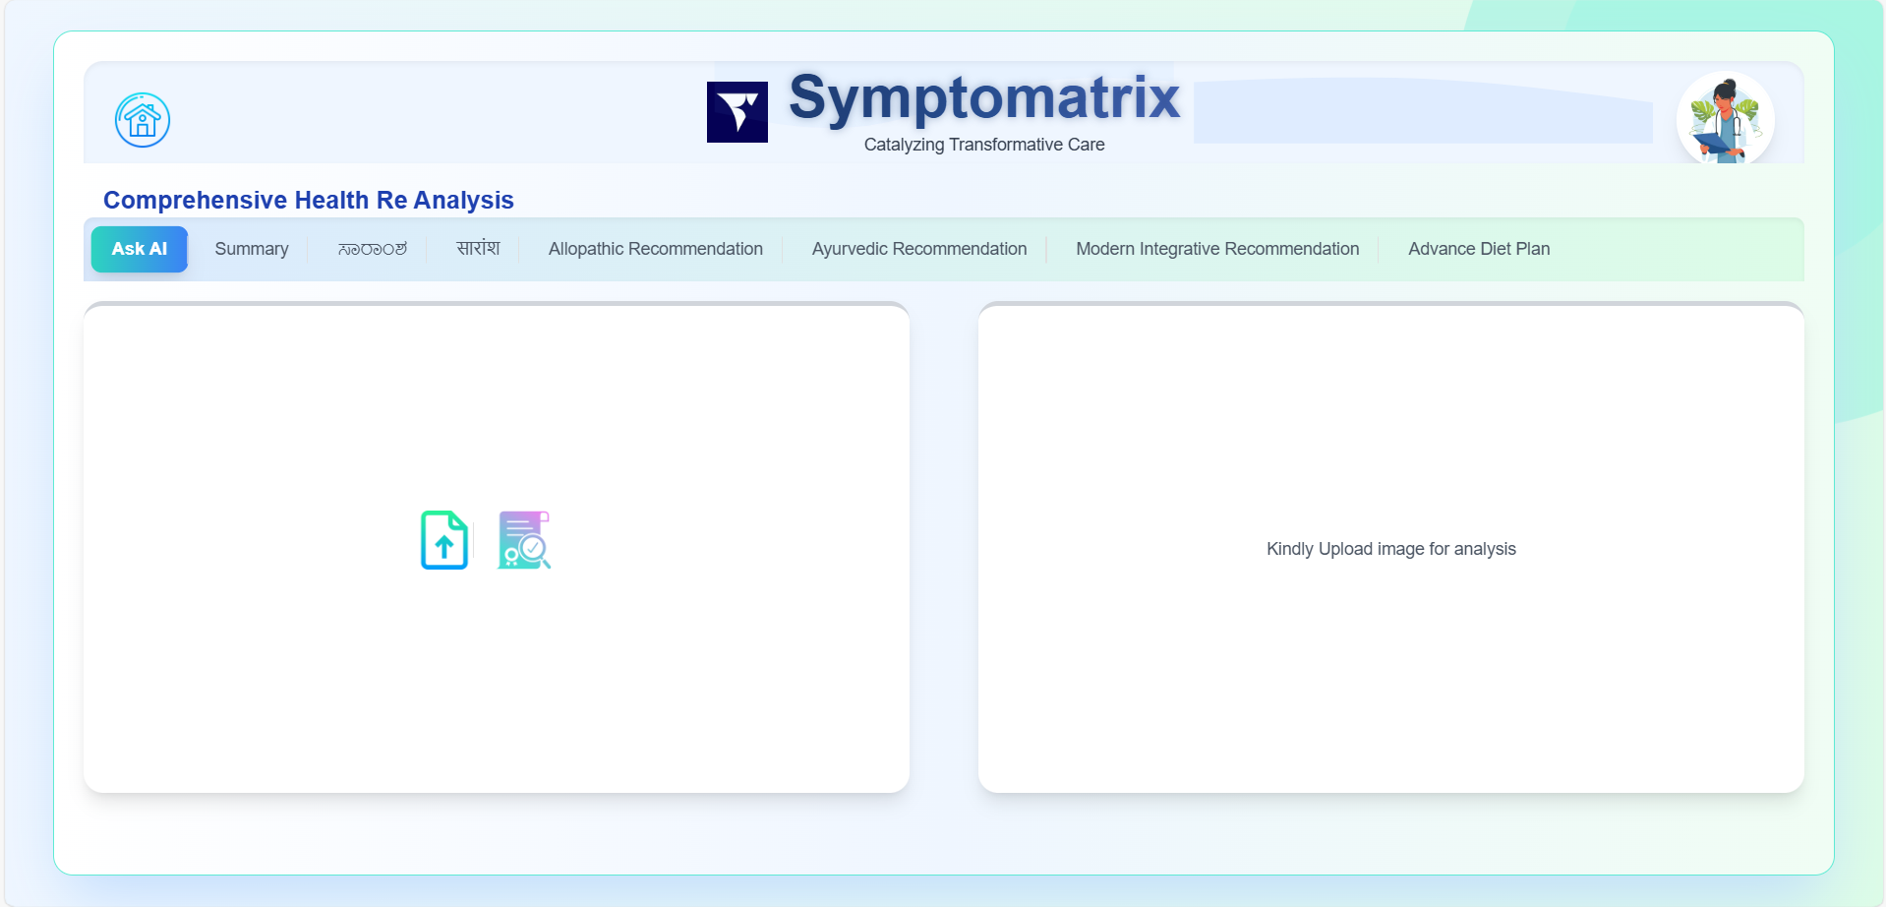
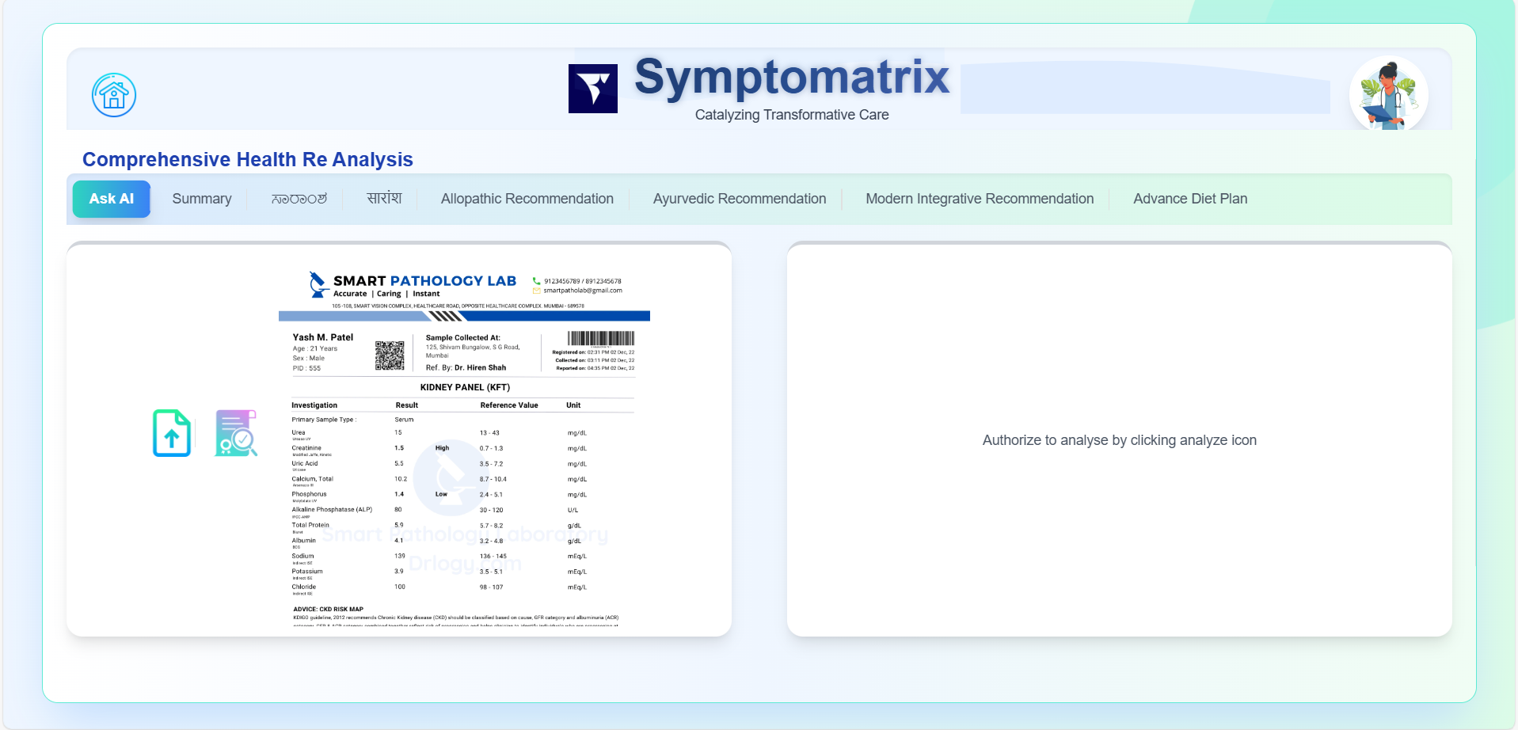
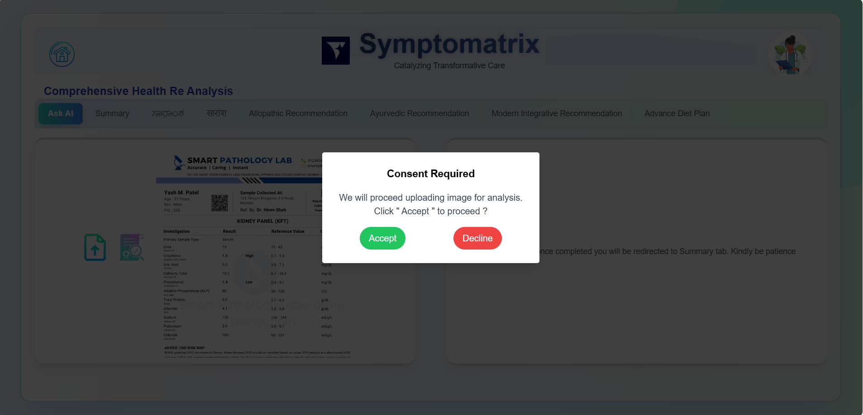
Application Screen Shot

Slide 15
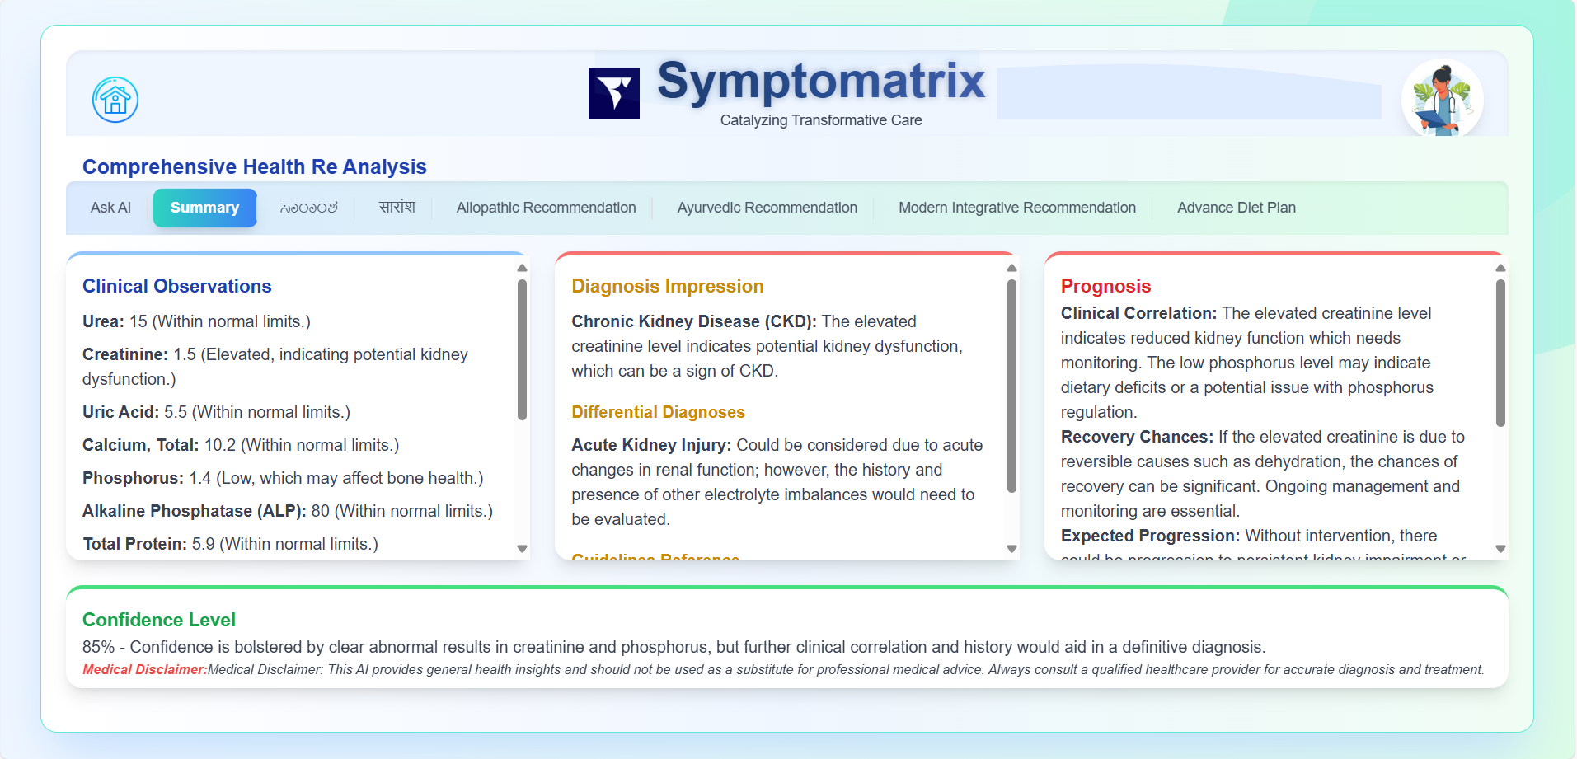
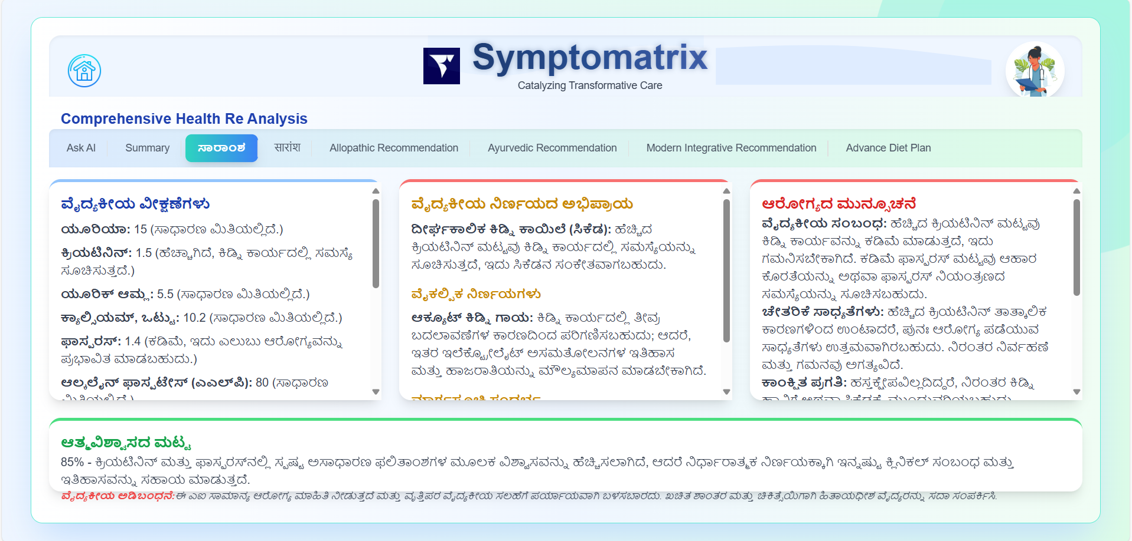
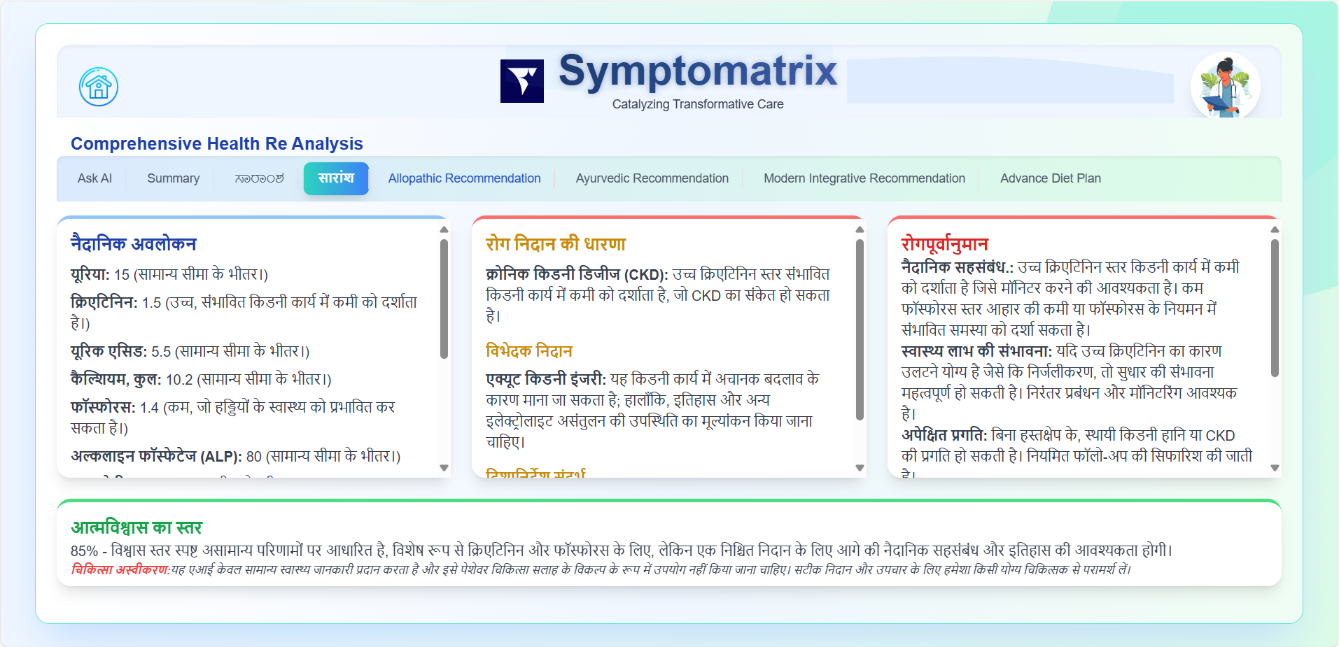
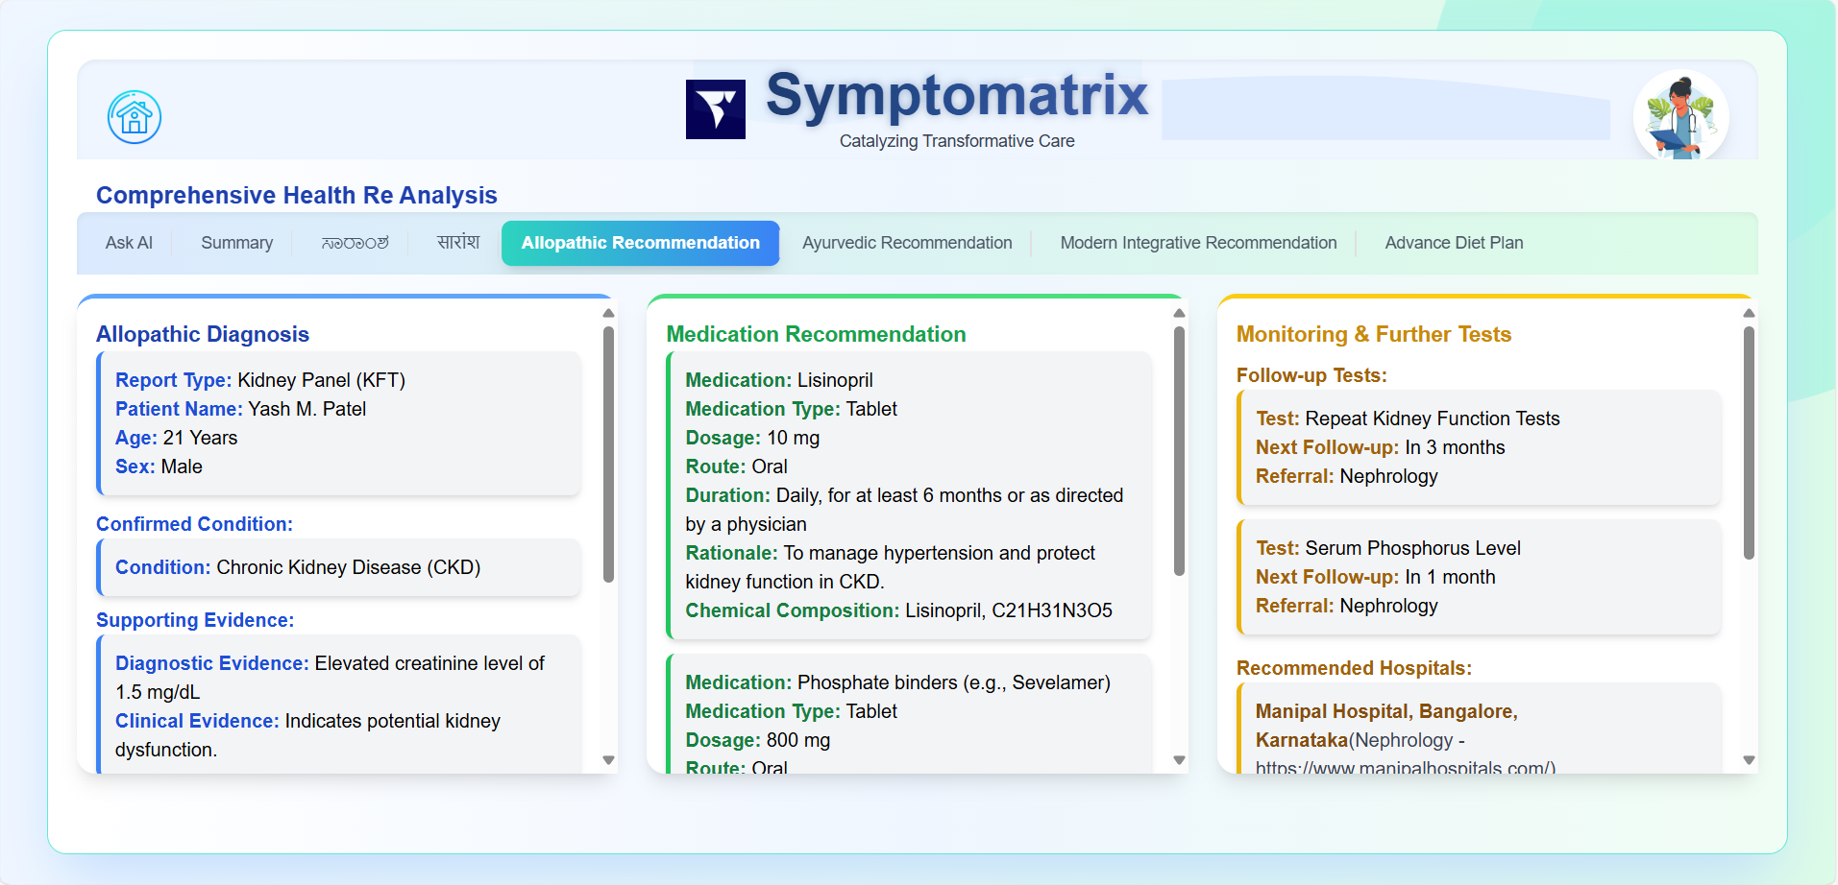

Slide 16
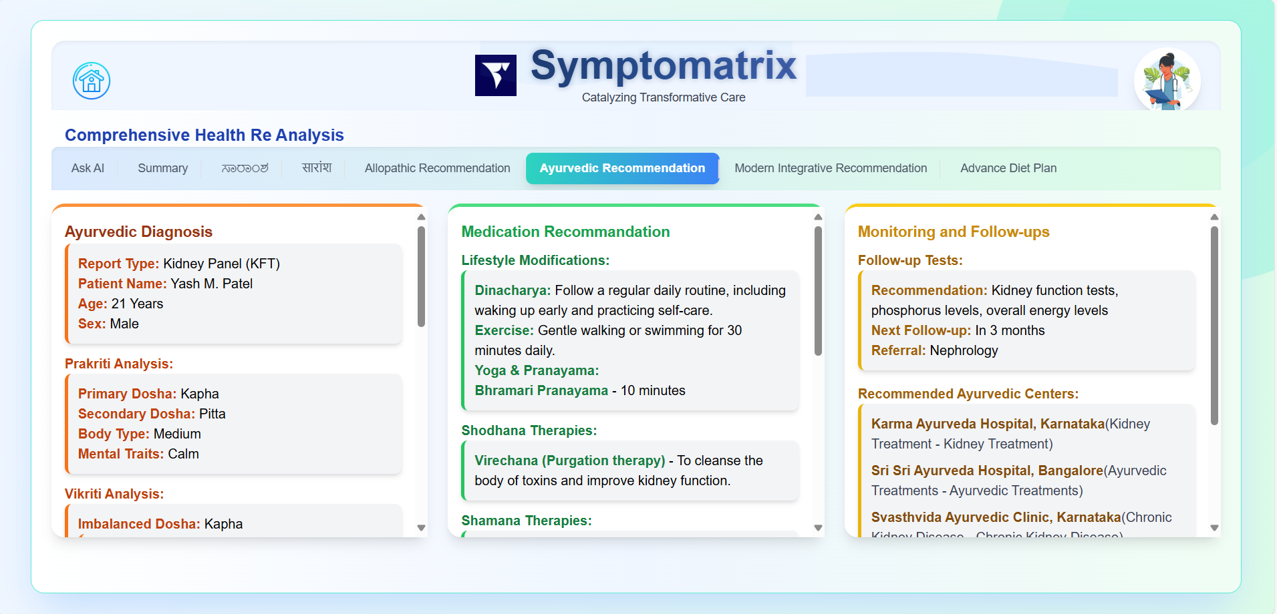
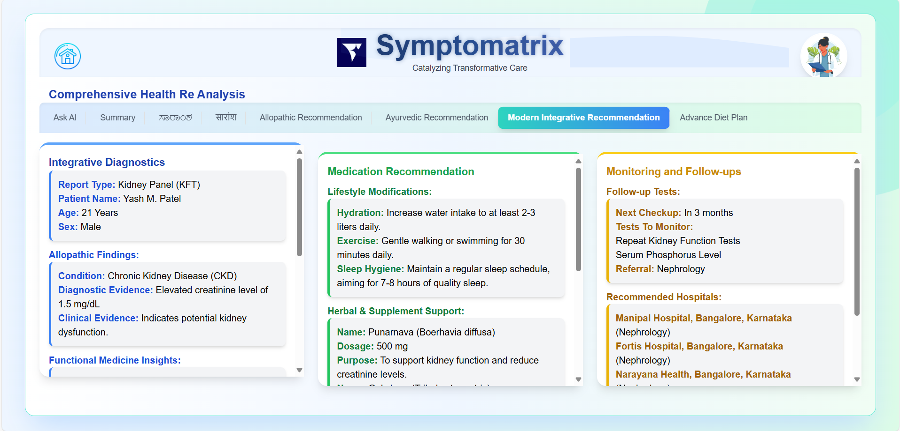
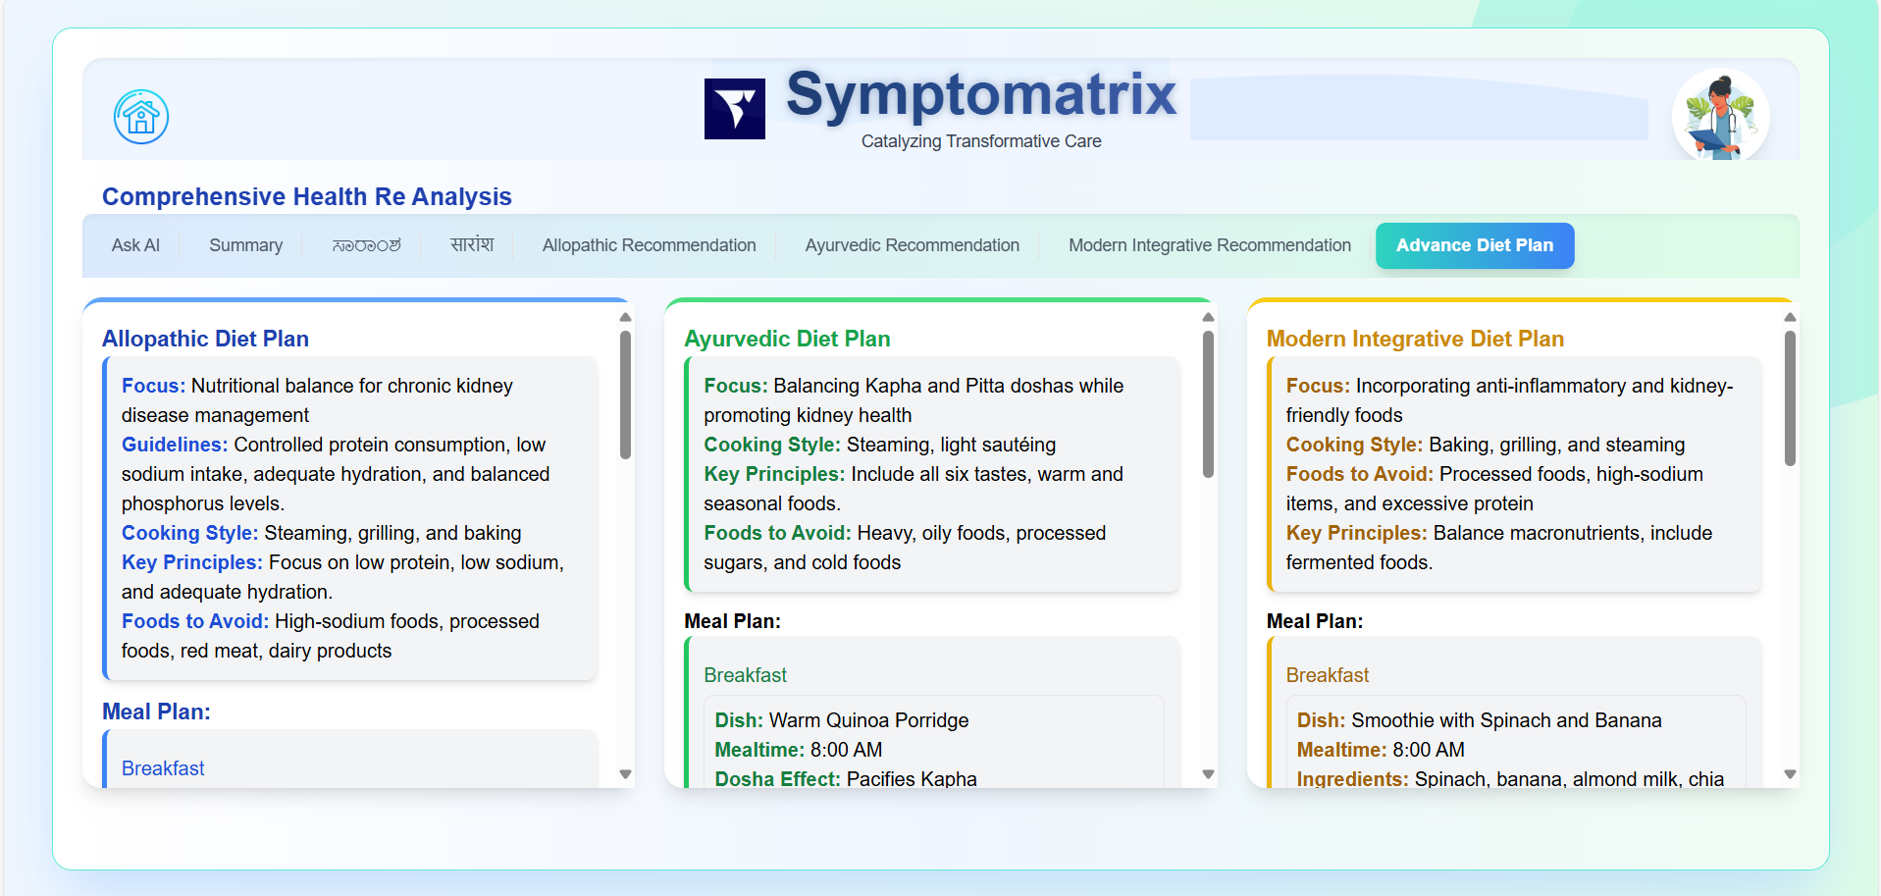

Slide 17


